Slide 1


Data Science Final Project
High School Track & Field and Cross-Country
Data Analysis
Wei-Hua Hsu (Wafer) | American University | Dec. 2

Slide 2

Overview
Rationale
Data Collection
Study Questions
Overview of Result
Interesting Findings
Conclusion
Future Works
References
Wafer Hsu | 2019

Slide 3


Background & Rationale
Track & Field and XC coach at AU Athletes
Environmental effects
HS Students performance
Social Economy
Household Income
FWS scholarship
Recruiting new athletes
Wafer Hsu | 2019
Notes:
Federal EFC (Expected Family Contribution)

Slide 4
Collect the Data
Gather/join sports, climate, and social economy data
(Statewide)
☁️
💰
🏃
U.S. High School Data
Track & Field and XC
(800, 1600, 3200, 5k)
(College Data, state info)
Median Household Income
(2013-2017)
U.S. yearly climate data
(Temp, rainfall, sunshine,
wind speed, altitude, humidity)

Slide 5
Study Questions
Statewide effects
Climate factors
Social Economy / Household income
Wafer Hsu | 2019
Notes:
Temperature has a significant impact on the performance of athletes

Slide 6

What does the statewide player performance look like?
Are there some states tend to have better performance?
Q1
Wafer Hsu | 2019

Slide 7
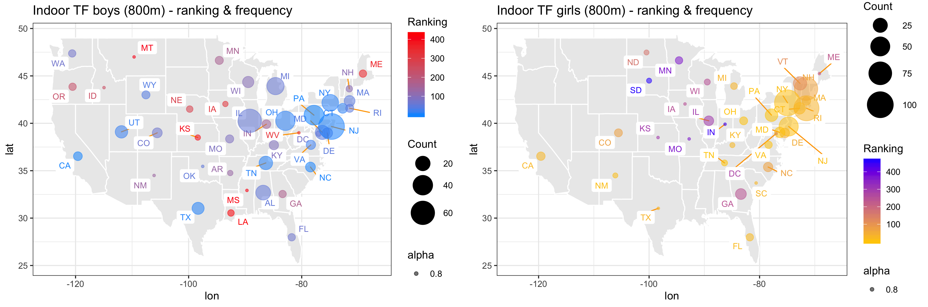
Q1
Indoor Track & Field – 800m
Wafer Hsu | 2019

Slide 8
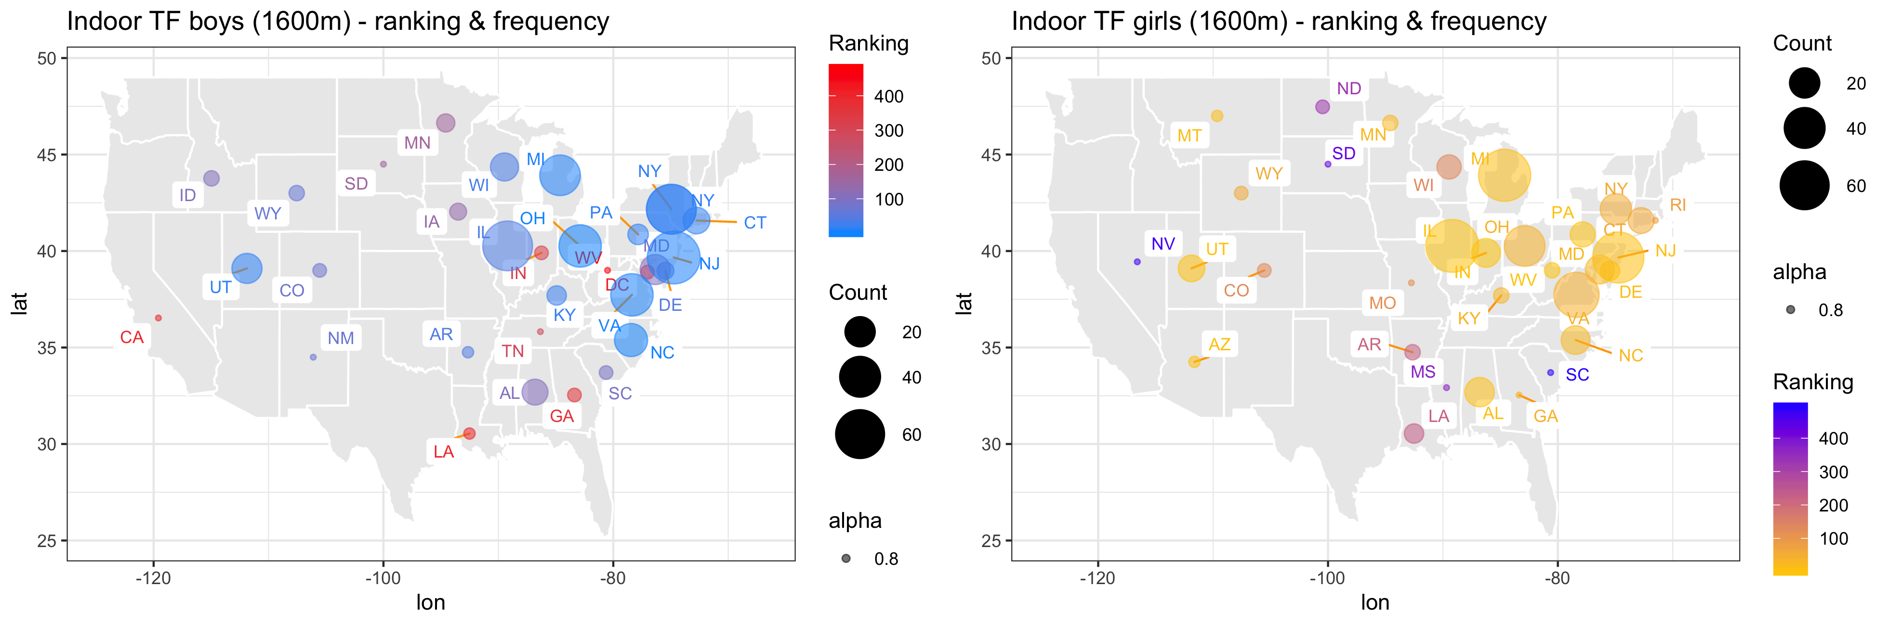
Q1
Indoor Track & Field – 1600m
Wafer Hsu | 2019

Slide 9
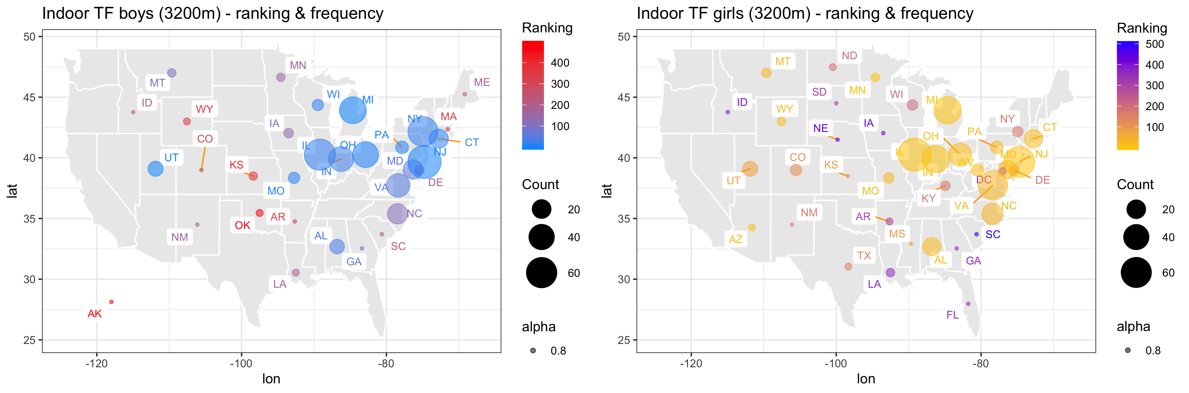
Q1
Indoor Track & Field – 3200m
Wafer Hsu | 2019

Slide 10
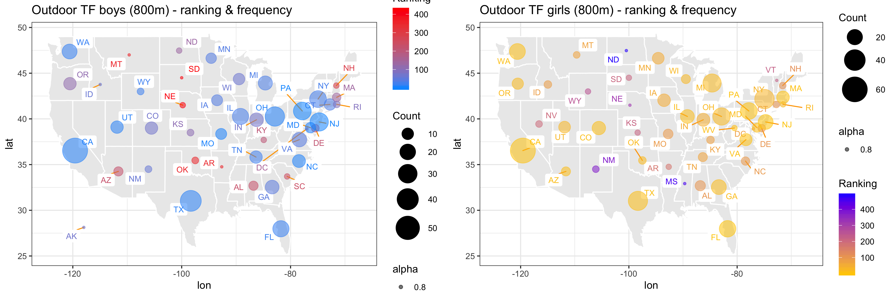
Q1
Outdoor Track & Field – 800m
Wafer Hsu | 2019

Slide 11
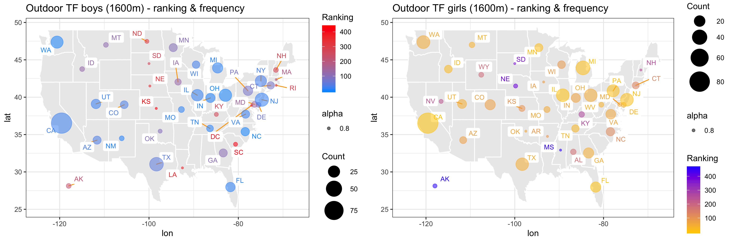
Q1
Outdoor Track & Field – 1600m
Wafer Hsu | 2019

Slide 12
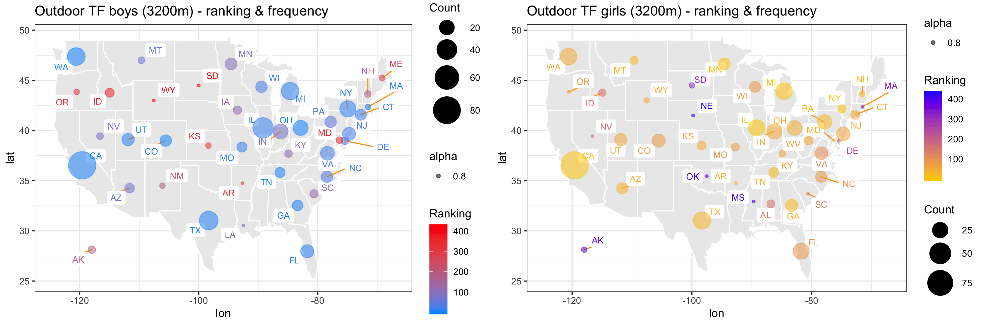
Q1
Outdoor Track & Field – 3200m
Wafer Hsu | 2019

Slide 13
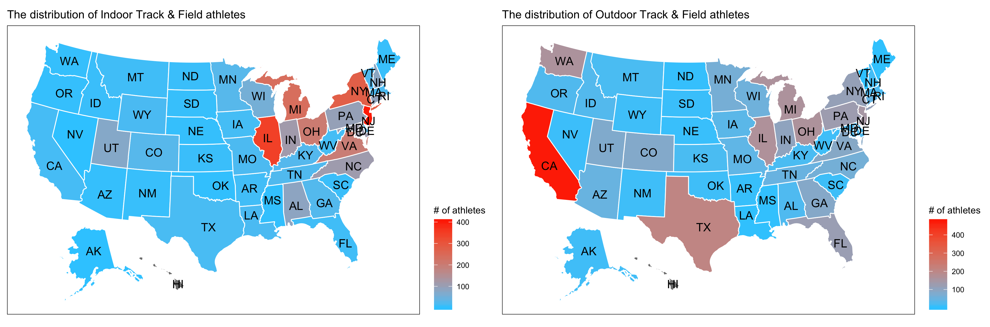
Indoor
Outdoor
Wafer Hsu | 2019

Slide 14
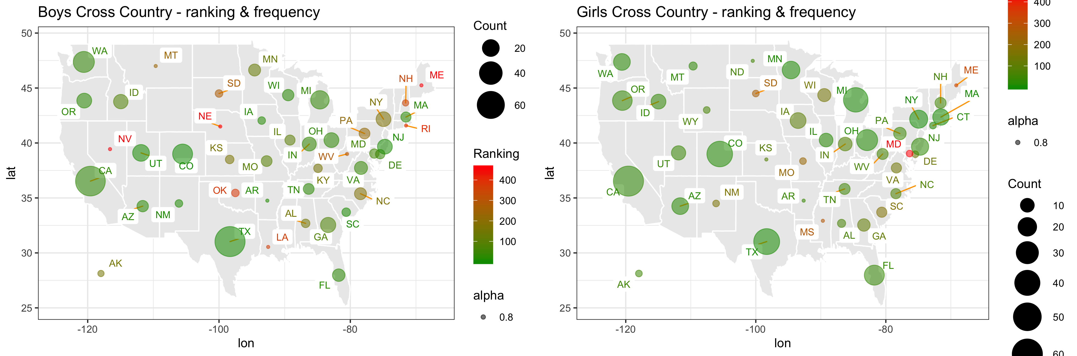
Q1
Cross Country – 5k
Wafer Hsu | 2019
Notes:
Spread out

Slide 15
Does climate matter? How does the climate factors (temperature, rainfall inches, humidity, sunshine hours, wind speed, elevations) relate to elite athletes in the U.S.?
Q2
Wafer Hsu | 2019

Slide 16
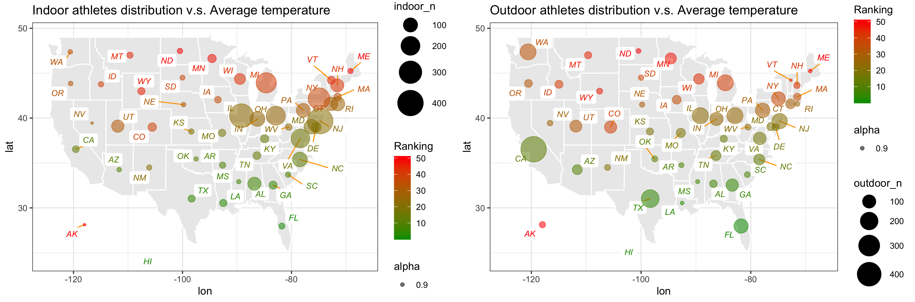
Temperature ✅
Wafer Hsu | 2019
Notes:
Temperature has a significant impact on the performance of athletes

Slide 17
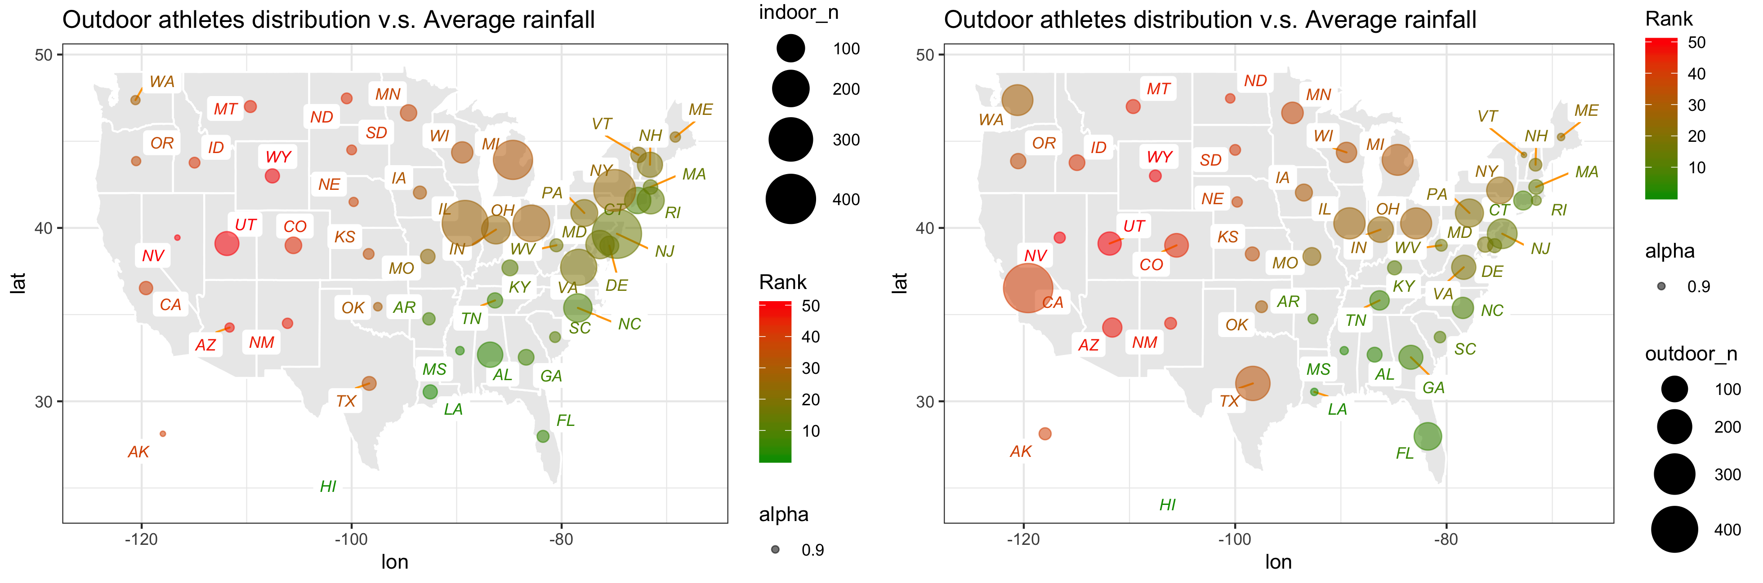
Precipitation ✅
Wafer Hsu | 2019
Notes:
Rank 1 = more rain
They don’t need to workout indoor (FL, CA, TX)

Slide 18
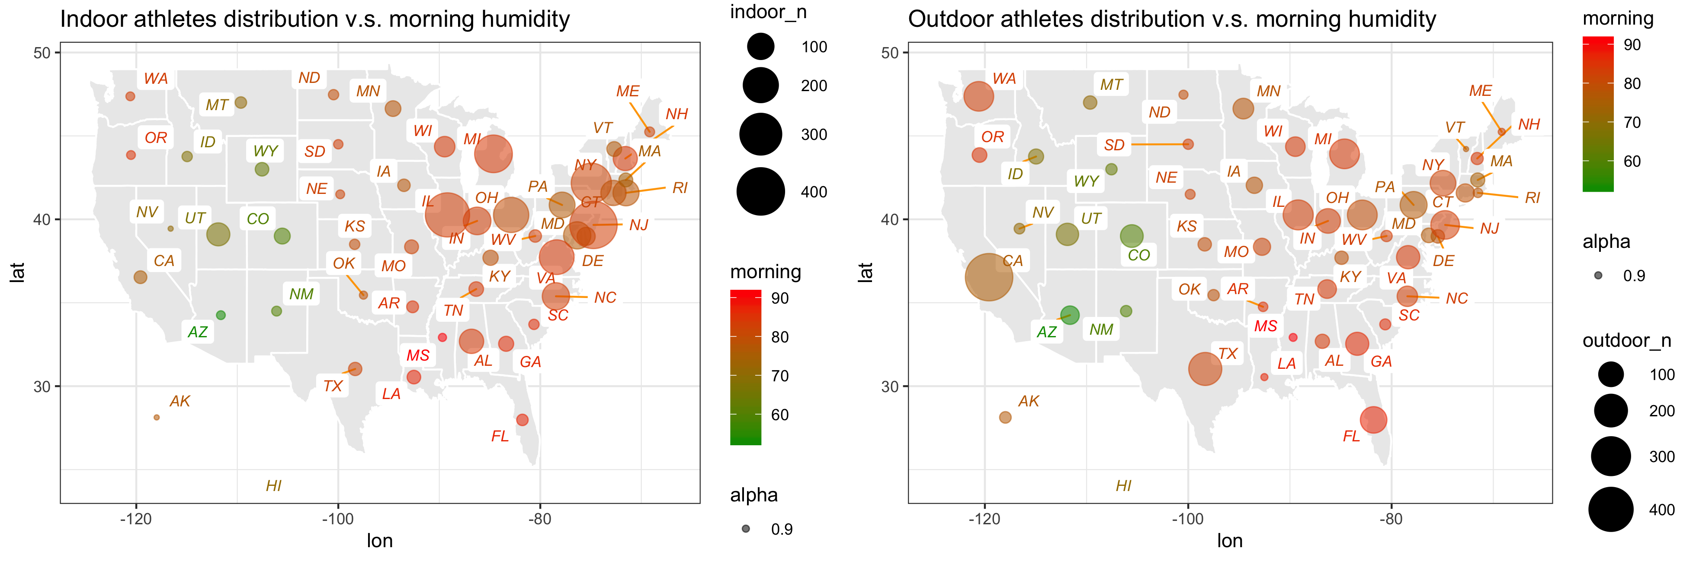
Morning/Afternoon Humidity ✅
Wafer Hsu | 2019
Notes:
Higher humidity
More humid
* Roof in northwest (cold) & AR state (hot)

Slide 19

Morning/Afternoon Humidity ✅
Wafer Hsu | 2019
Notes:
Higher humidity
More humid
* Roof in northwest (cold) & AR state (hot)

Slide 20
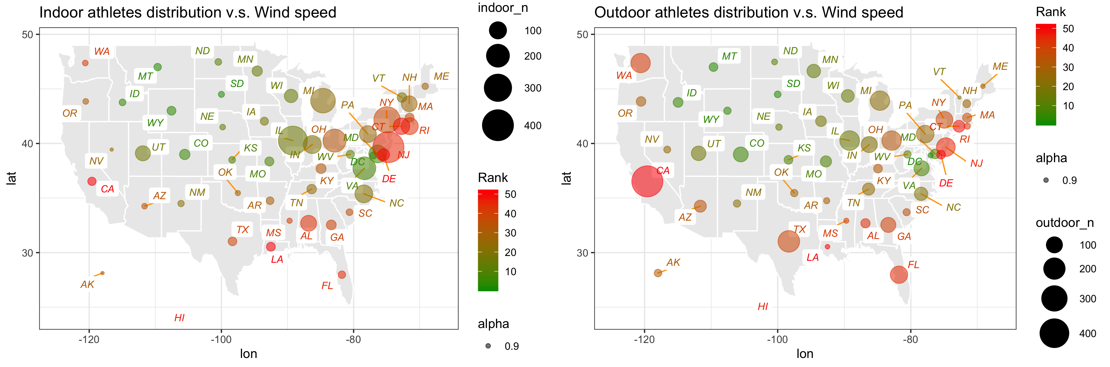
Wind Speed
Wafer Hsu | 2019
Notes:
Rank1 = faster

Slide 21
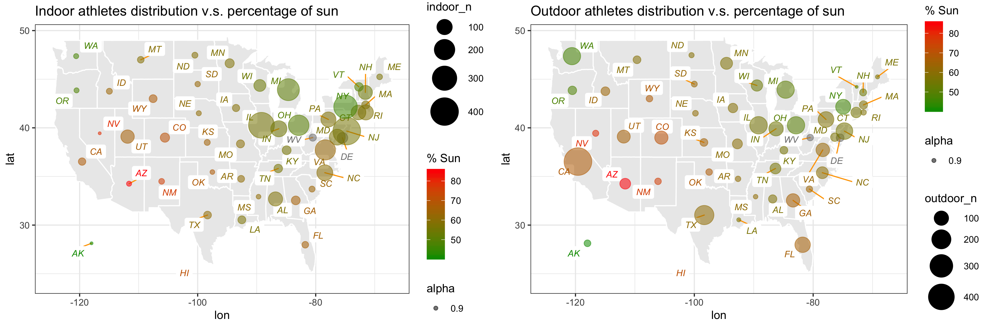
Sunshine Hours ✅
Wafer Hsu | 2019

Slide 22
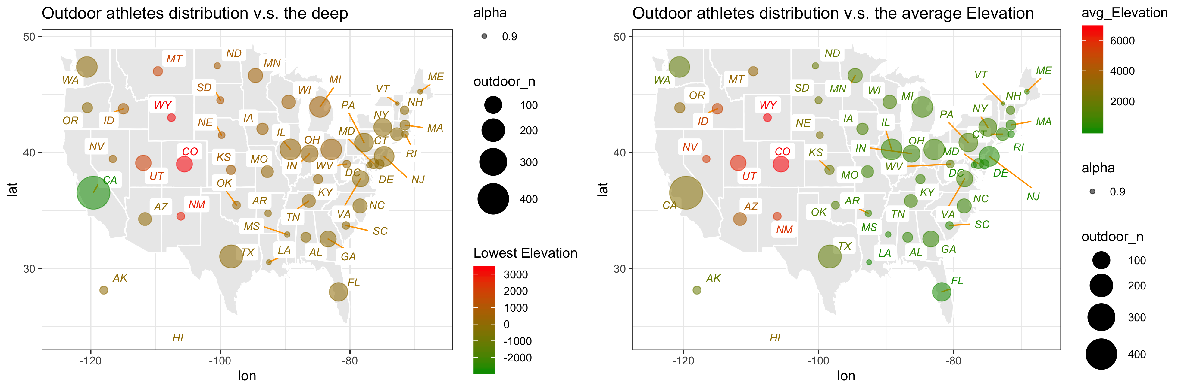
Elevation
Wafer Hsu | 2019

Slide 23
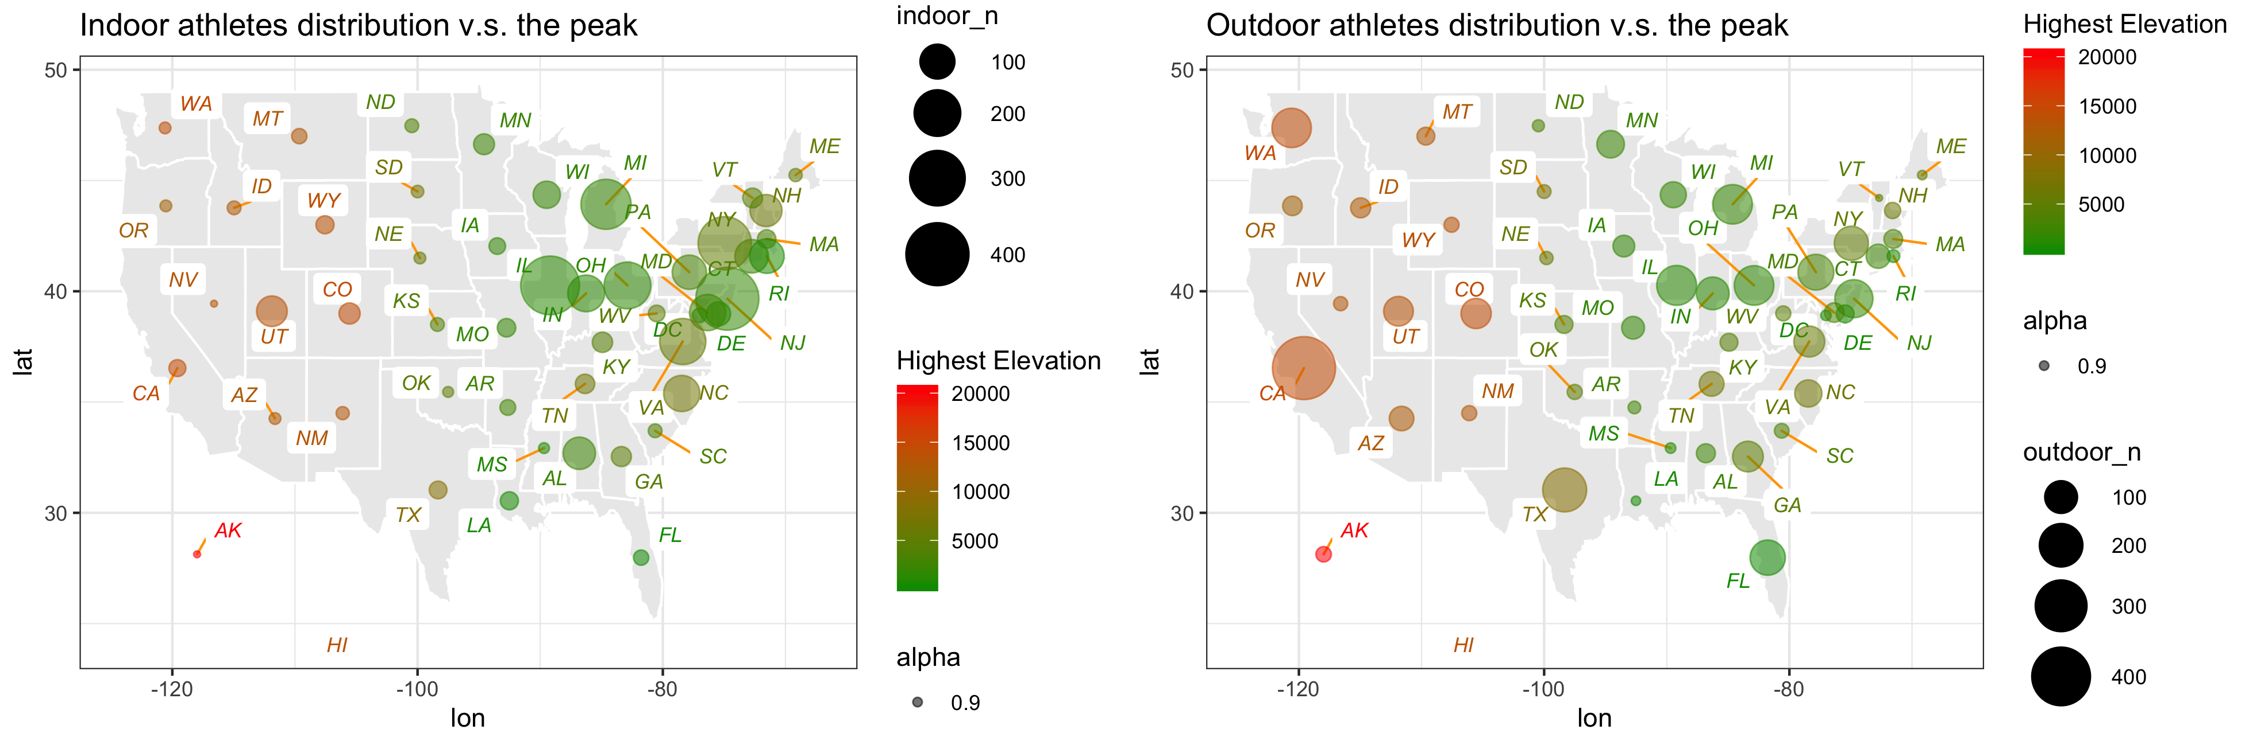
Elevation
Wafer Hsu | 2019

Slide 24

Climate factors have a significant impact on the performance of athletes.
Climate factors have a significant impact on the performance of athletes.
Wafer Hsu | 2019

Slide 25
Q3
How wealthy are those outstanding athletes? Is there any lower-income state that tends to have a better performance of athletes?
Wafer Hsu | 2019

Slide 26
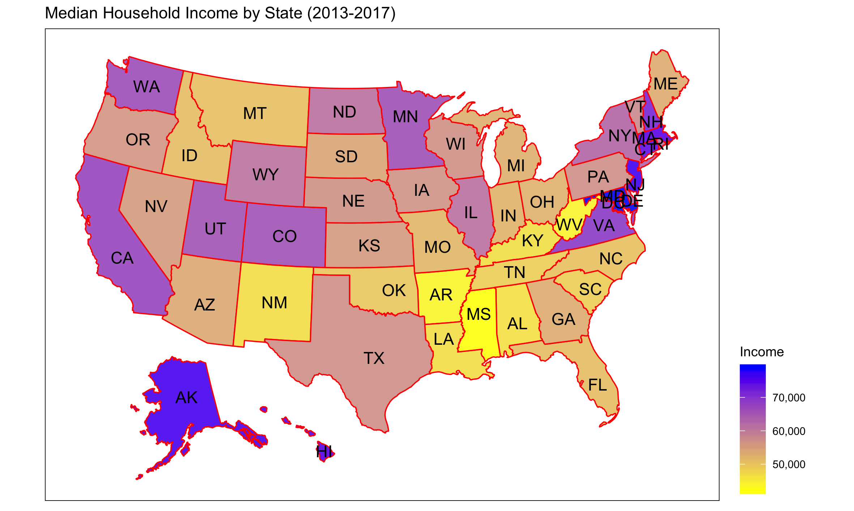
Q3
Wafer Hsu | 2019

Slide 27
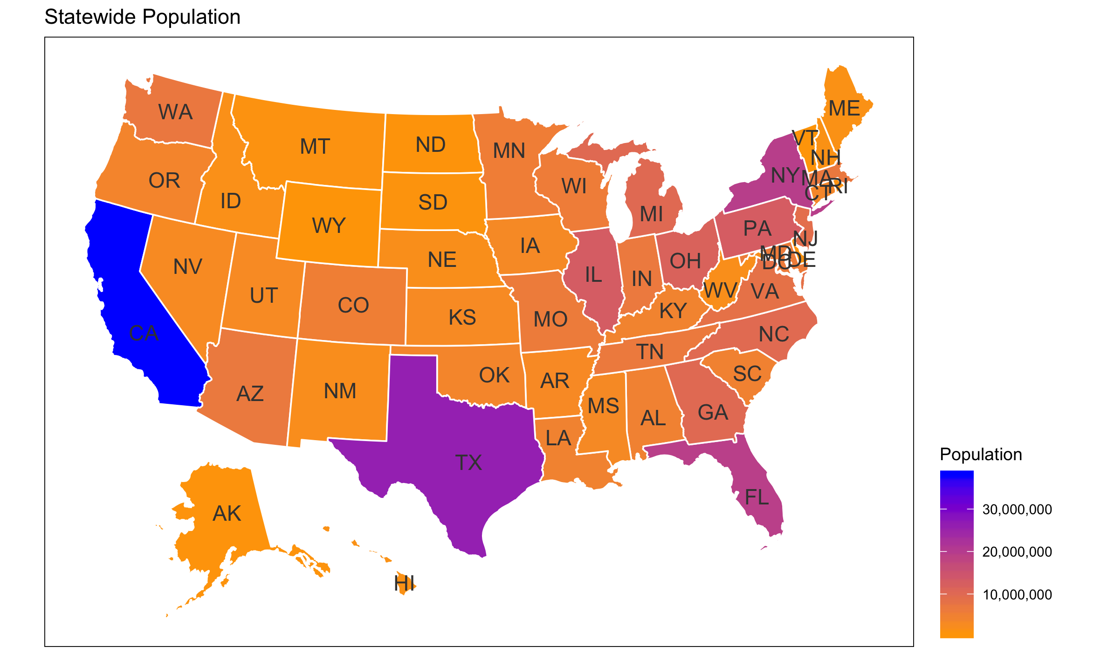
Q3
Wafer Hsu | 2019
Notes:
Which means all facts are interconnected. Natural condiction

Slide 28
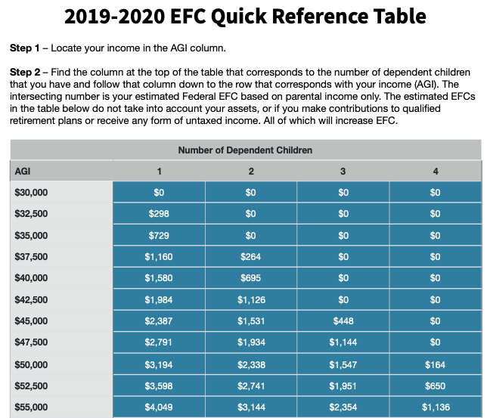
Conclusion & Recommendation
Can we find the possible outstanding athletes?
Indoor T&F
Cross Country
Outdoor T&F
PA, OH, IL
NJ, NY, MD, VA
-
TX, FL, CO
WA, CA
Wafer Hsu | 2019
Notes:
Natural conclusion
(weather, population, wealth)

Slide 29


Future Work
Athletes’ hometown
For college data
or
Cross analysis between
College v.s. High School
Country data
Yearly changes
Deeper exploration
2008-2018
Notes:
Then there are factors such as the temperature, allergens, pollution and altitude that cannot be controlled and can have serious effects on human performance.

Slide 30
References
- NOAA (National Oceanic and Atmospheric Administration) https://www.ncdc.noaa.gov/cag/statewide/mapping/110/pcp/201812/12/value
- Current Results
https://www.currentresults.com/Weather/US/average-annual-state-sunshine.php
https://www.currentresults.com/Weather/US/annual-average-humidity-by-state.php
- USA.com
http://www.usa.com/rank/us--average-wind-speed--state-rank.htm
- Smart Search
https://smart-search.app/resources/2019-2020-efc-quick-reference.pdf
- Census Bureau
https://www.census.gov/search-results.html?searchType=web&cssp=SERP&q=annual%20income
- infoplease.com
https://www.infoplease.com/world/united-states-geography/highest-lowest-and-mean-elevations-united-states
- MileSplit
https://www.milesplit.com/
- TFRRS
https://tfrrs.org/
- American University Athletics
https://aueagles.com/sports/track-and-field/roster#sidearm-m-roster
Wafer Hsu | 2019

Slide 31

Thank you!
ShinyApp:
https://wafer110.shinyapps.io/Shiny_WeiHuaHsu/
Wei-Hua Hsu (Wafer)
MS of Data Science
EMAIL ADDRESS
wh0225a@student.american.edu
Wafer Hsu | 2019
Notes:
https://wafer110.shinyapps.io/Shiny_WeiHuaHsu/

